Slide 1
VHDL Simulation
Testbench Design

Slide 2
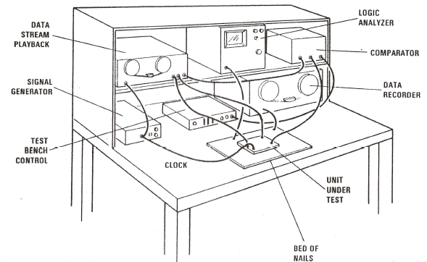
The Test Bench Concept

Slide 3
Project simulations
Behavioral/RTL – verify functionality
  Model in VHDL/Verilog
  Drive with “force file” or testbench
Post-Synthesis
  Synthesized gate-level VHDL/Verilog netlist
  Technology-specific VHDL/Verilog gate-level models
  Optional SDF file (from synthesis) for timing
  Drive with same force file/testbench as in (1)
Post-Layout
  Netlist back-annotated with extracted capacitances for accurate delays

Slide 4
Example: modulo-7 counter
VHDL Model (modulo7.vhd)
  Create working library: vlib work
  Map the lib name: vmap work work
  Compile: vcom modulo7.vhd
  Simulate: vsim modulo7(behave)
Simulation-control
  Modelsim “macro” file (mod7.do)
  Testbench (VHDL or Verilog)
ModelSim results
  List(table) and/or Waveform (logic analyzer)

Slide 5
-- modulo7.vhd parallel-load modulo-7 synchronous counter
library ieee; use ieee.std_logic_1164.all;
use ieee.numeric_std.all;
entity modulo7 is
port(reset,count,load,clk: in std_logic;
I: in std_logic_vector(2 downto 0);
Q: out std_logic_vector(2 downto 0));
end modulo7;
architecture Behave of modulo7 is
signal Q_s: unsigned(2 downto 0);
begin
process (reset,clk) begin
if (reset='0') then
Q_s <= "000";
elsif (clk'event and (clk='1')) then
if (count = '1') and (Q_s = "110") then
Q_s <= "000";
elsif (count='1') then
Q_s <= Q_s + 1;
elsif (load='1') then
Q_s <= UNSIGNED(I);
end if;
end if;
end process;
Q<=STD_LOGIC_VECTOR(Q_s);
end Behave;

Slide 6
Test stimulus:
Modelsim “do” file: mod7.do
add wave /clk /reset /count /load
add wave -hex /I /Q
add list /clk /reset /count /load
add list -hex /I /Q
force /clk 0 0 ns, 1 20 ns -repeat 40 ns
force /I 101 0 ns, 011 400 ns
force /reset 1 0 ns, 0 10 ns, 1 20 ns
force /count 0 0 ns, 1 90 ns, 0 490 ns
force /load 0 0 ns, 1 30 ns, 0 70 ns
run 600 ns

Slide 7
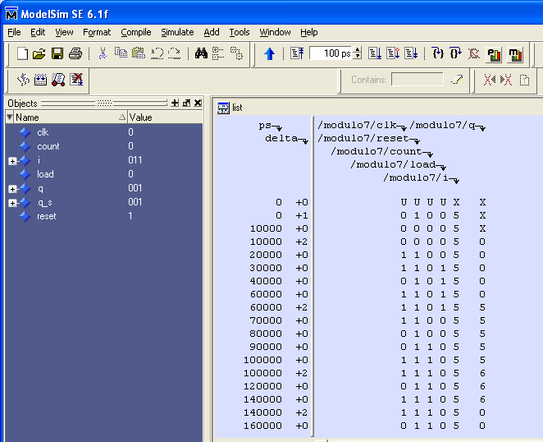
Results in list format
Note “delta”
delays for
behavioral
model.

Slide 8
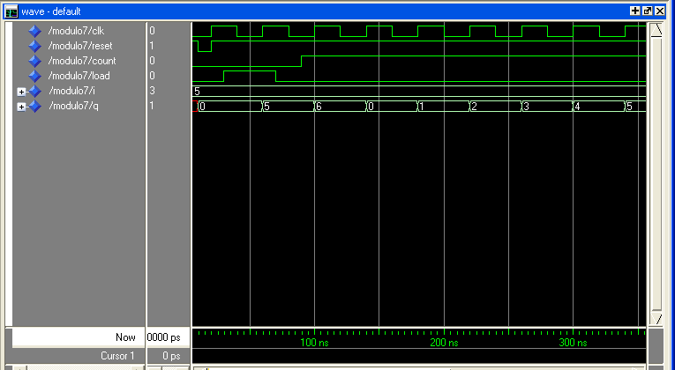
Results in wave format

Slide 9
Elements of a VHDL/Verilog testbench
Unit Under Test (UUT) – or Device Under Test (DUT)
  instantiate one or more UUT’s
Stimulus of UUT inputs
  algorithmic
  from arrays
  from files
Checking of UUT outputs
  assertions
  write to files

Slide 10
Instantiating the UUT
-- 32 bit adder testbench
entity adder_bench is -- no top-level I/O ports
end adder_bench;
architecture test of adder_bench is
component adder is -- declare the UUTs
port (
X,Y: in std_logic_vector(31 downto 0);
Z: out std_logic_vector(31 downto 0)
);
signal A,B,Sum: std_logic_vector(31 downto 0); --internal signals
begin
UUT: adder port map (A,B,Sum); --instantiate the adder

Slide 11
Example – stimulating clock inputs
-- Simple 50% duty cycle clock
clk <= not clk after T ns; -- T is constant or defined earlier
-- Clock process, using “wait” to suspend for T1/T2
process begin
clk <= ‘1’; wait for T1 ns; -- clk high for T1 ns
clk <= ‘0’; wait for T2 ns; -- clk low for T2 ns
end process;
-- Clock “procedure” (define in declaration area or in a package)
procedure Clock (signal C: out bit; HT, LT: TIME) is begin
loop -- schedule “waveform” on C and suspend for period
C <= ‘1’ after LT, ‘0’ after LT + HT; wait for LT + HT;
end loop;
end procedure;
-- “execute” clock procedure by instantiating it in the architecture
C1: Clock (CLK, 10ns, 8 ns);

Slide 12
Algorithmic generation of stimulus
-- Generate test values for an 8-bit adder inputs A & B
process begin
for m in 0 to 255 loop -- all 8 bit addend values
for n in 0 to 255 loop -- all 8 bit augend values
A <= to_std_logic(m); -- apply m to adder input A
B <= to_std_logic(n); -- apply n to adder input B
wait for T ns; -- allow time for addition
assert (to_integer(Sum) = (m + n)) -- expect Sum = A + B
report “Incorrect sum” severity note;
end loop; end loop;
end process;

Slide 13
Sync patterns with clock transitions
-- Test 4x4 bit multiplier algorithm
process begin
for m in 0 to 15 loop;
for n in 0 to 15 loop;
A <= to_std_logic(m); -- apply multiplier
B <= to_std_logic(n); -- apply multiplicand
wait until CLK’EVENT and CLK = ‘1’; -- clock in A & B
wait for 1 ns; -- move next change past clock edge
Start <= ‘1’, ‘0’ after 20 ns; -- pulse Start signal
wait until Done = ‘1’; -- wait for end of multiply
wait until CLK’EVENT and CLK = ‘1’; -- finish last clock
end loop; end loop; end process;

Slide 14
Reading test patterns from files
use std.textio.all; -- Contains file/text support
architecture m1 of bench is begin
signal Vec: std_logic_vector(7 downto 0); -- test vector
process
file P: text open read_mode is "testvecs"; -- test vector file
variable LN: line; -- temp variable for file read
variable LB: bit_vector(31 downto 0); -- for read function
begin
while not endfile(P) loop -- Read vectors from data file
readline(P, LN); -- Read one line of the file (type “line”)
read(LN, LB); -- Get bit_vector from line
Vec <= to_stdlogicvector(LB); -- Vec is std_logic_vector
end loop; end process;

Slide 15
Test vectors from an array
type vectors is array (1 to N) of std_logic_vector(7 downto 0);
signal V: vectors := -- initialize vector array
(
"00001100 “, -- pattern 1
"00001001“, -- pattern 2
"00110100", -- pattern 3
. . . .
"00111100“ -- pattern N
);
begin
A <= V(i); -- set A to ith vector

Slide 16
Check results with assertions
-- Assert statement checks for expected condition
assert (A = (B + C)) -- expect A = B+C (any boolean condition)
report “Error message”
severity NOTE;
-- Print “Error message” if assert condition FALSE
(condition is not what we expected)
-- Specify one of four severity levels:
NOTE, WARNING, ERROR, FAILURE
-- Modelsim allows selection of severity level that should
halt the simulation
-- Severity level NOTE generally should not stop simulation

Slide 17
Check timing constraints
-- Tsu for flip flop D input before clock edge is 2ns
assert not (CK’stable and (CK = ‘1’) and not D’stable(2ns))
report “Setup violation: D not stable for 2ns before CK”;
-- DeMorgan equivalent
assert CK’stable or (CK = ‘0’) or D’stable(2ns)
report “Setup violation: D not stable for 2ns before CK”;

Slide 18
Testbench: modulo7_bench.vhd
LIBRARY ieee;
USE ieee.std_logic_1164.all;
USE ieee.numeric_std.all;
ENTITY modulo7_bench is end modulo7_bench;
ARCHITECTURE test of modulo7_bench is
component modulo7
PORT (reset,count,load,clk: in std_logic;
I: in std_logic_vector(2 downto 0);
Q: out std_logic_vector(2 downto 0));
end component;
for all: modulo7 use entity work.modulo7(Behave);
signal clk : STD_LOGIC := '0';
signal res, cnt, ld: STD_LOGIC;
signal din, qout: std_logic_vector(2 downto 0);
begin
-- instantiate the component to be tested
UUT: modulo7 port map(res,cnt,ld,clk,din,qout);
Alternative
to “do” file
Continue on
next slide

Slide 19
Testbench: modulo7_bench.vhd
qint = expected outputs of UUT
clk <= not clk after 10 ns;
P1: process
variable qint: UNSIGNED(2 downto 0);
variable i: integer;
begin
qint := "000";
din <= "101"; res <= '1';
cnt <= '0'; ld <= '0';
wait for 10 ns;
res <= '0'; --activate reset for 10ns
wait for 10 ns;
assert UNSIGNED(qout) = qint
report "ERROR Q not 000"
severity WARNING;
res <= '1'; --deactivate reset
wait for 5 ns; --hold after reset
ld <= '1'; --enable load
wait until clk'event and clk = '1';
qint := UNSIGNED(din); --loaded value
wait for 5 ns; --hold after load
ld <= '0'; --disable load
cnt <= '1'; --enable count
for i in 0 to 20 loop
wait until clk'event and clk = '1';
assert UNSIGNED(qout) = qint
report "ERROR Q not Q+1"
severity WARNING;
if (qint = "110") then
qint := "000"; --roll over
else
qint := qint + "001"; --increment
end if;
end loop;
end process;
Print message if incorrect result

